Slide 1
Subtopic N3.18 - Short Division (remainders)
LEARNING OUTCOME: To understand how to apply short division to solve problems.
Keywords:
Divide
Share
Dividend
Divisor
Objectives:
To use short division where there is a remainder.
To use short division to solve problems in context.
Introduction – read and annotate:
Sometimes when you divide, the number doesn’t split exactly—and you’re left with a remainder. In
this lesson, you’ll learn how to write remainders properly and understand what they mean in
different contexts. This is an important step before moving on to decimal answers, because it helps
you decide whether to stop with a remainder, round, or continue dividing. Being confident with
remainders will also help you in problem-solving tasks where you need to interpret what the extra
amount actually represents.
Definition
Characteristics
Splitting a number into equal parts.​
Involves two numbers: dividend and divisor.
The result of division is called the quotient.
Division can result in a whole number, a fraction, or a decimal, depending on the numbers involved.
Division is denoted by the symbol "÷" or the fraction bar "⁄"
Examples
Division
Non - Examples
10 ÷ 2 = 5
8 ÷ 4 = 2
21 ÷ 7 = 3
1.5 ÷ 0.5 = 3
Addition and subtraction are not division operations.
Multiplication is the inverse of division but is a different operation.
Ratios and proportions are related concepts but are not division.
Short division with remainders
Example 1 – I do…
Example 2 – We do…
Example 3 – You do…
Steps
1) Set out the short division, making sure the divisor is on the outside. 2) Starting from the left, divide into each digit, carrying where necessary. 3) Leave your answer as a remainder.
12r1
121r2
321r2
14r3
171r2
257r4

Slide 2
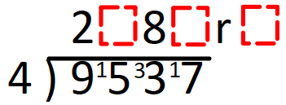
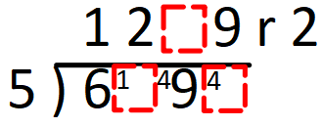
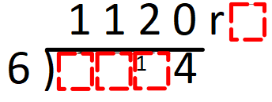
Independent Practice
Question 1. For the following questions, leave your answers as a remainder.
19r3
15r3
18r2
179r1
97r1
46r4
97r6
235r1
167r3
942r7
1151r5
1534r1
3092r1
978r4
98r5
150r5
13657r1
1084r4
Question 2. For the following questions, fill in the missing blanks.
a) | b) | c)
3 4 1
9
4
4 7
6 7 2

Slide 3
Question 3. Simon is sharing 27 marbles equally between 4 friends. How many marbles are left over? | Question 4. Rebecca is selling raffle tickets in booklets of 5. She has 86 raffle tickets. How many booklets can Rebecca sell? How many tickets will be left over? | Question 5. Eggs are being packed into boxes of 6. Farmer Richards has 77 eggs. How many boxes can he fill? How many eggs will be left over?
Question 6. At a wedding there are 125 guests. 8 people can sit at each table. All the tables are filled, except one. How many guests sit at the table that is not filled? | Question 7. A square tile has a perimeter of 180cm. A tiler is going to cut the tile into 6 equal rectangular strips, with some spare left over. What will the dimensions be of the piece that is left over? | Question 8. A square lawn has a perimeter of 240m. A gardener is going to cut up the lawn into 16 equal rectangular strips, with some spare left over. What will the dimensions be of the piece that is left over?
17
12
3
1
5
5
3cm x 45cm
12m x 60m
Question 9. Paul has £10 to buy rulers at 60p each. What change should he get if he buys as many as possible?
40p

